Slide 1
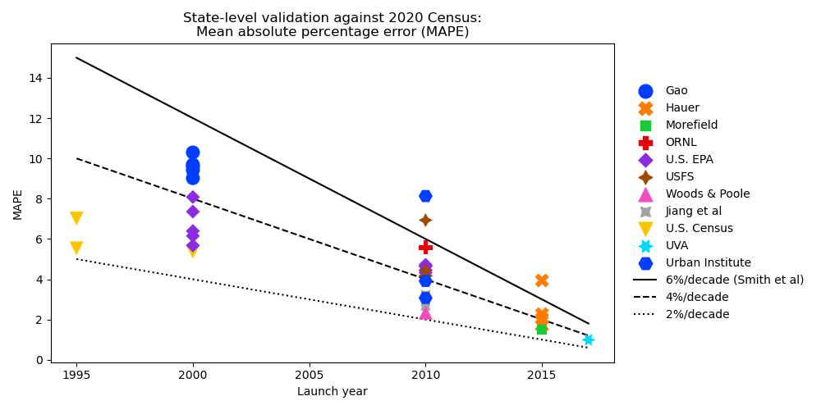

Slide 2
National Land Use Database
High-resolution (90m) land use data for CONUS
Theobald, D. (2014)
Integrated Climate and Land Use Scenarios (ICLUS), version 2
Uses NLUD transition probabilities (2000→2010)
NLUD for ICLUS v3
Modify some land use classes
Retain 30m resolution
Improve documentation and reproducibility
Quantify classification accuracy

